Slide 1

SPOOKY AUTHOR IDENTIFICATION
Team Members :
Anoop Jeerige
Rounak Kulkarni
Sanika Deshpande
Sweety Jain
Mohit Kirange

Slide 2
Agenda
Overview of Competition
Details of Dataset
Data Analysis
Exploratory Data Analysis
Implementation Steps
Dataset preprocessing model
Training a classifier
Enhancement
Parameter tuning using grid search MultinomialNB with stop words
Parameter tuning using grid search MultinomialNB without stop words
Experiment 2 – Ngram
Experiment 3 – Lemmatization
Result of All submission
Fun Experiment
Future Scope
Conclusion
References

Slide 3
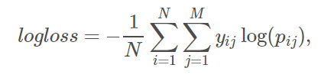
Overview of Competition
Challenge: To accurately identify the author of the sentences in the test set.
Evaluation : Based on multi-class logarithmic loss.
Submission : .csv file with the id and a probability for each of the three classes

Slide 4
Details of Dataset
The dataset contains text from works of fiction written by spooky authors of the public domain: Edgar Allan Poe, HP Lovecraft and Mary Shelley.
The data was prepared by chunking larger texts into sentences using CoreNLP's MaxEnt sentence tokenizer.
File descriptions
train.csv - the training set
test.csv - the test set
sample_submission.csv - a sample submission file in the correct format

Slide 5
Details of Dataset
Data Fields (train.csv)
id - a unique identifier for each sentence
text - some text written by one of the authors
Author(label) - the author of the sentence (EAP: Edgar Allan Poe, HPL: HP Lovecraft; MWS: Mary Wollstonecraft Shelley)
Data Fields (test.csv)
id - a unique identifier for each sentence
text - some text written by one of the authors

Slide 6
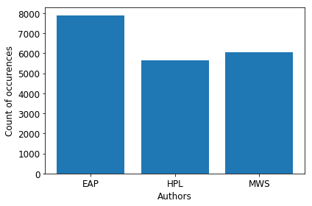
Exploratory Data Analysis– Sentence Distribution
Aim: Find Patterns and Insights in Data
Checking the author frequencies of training data
Author statistic :
EAP-7900
MWS-6044
HPL-5635

Slide 7
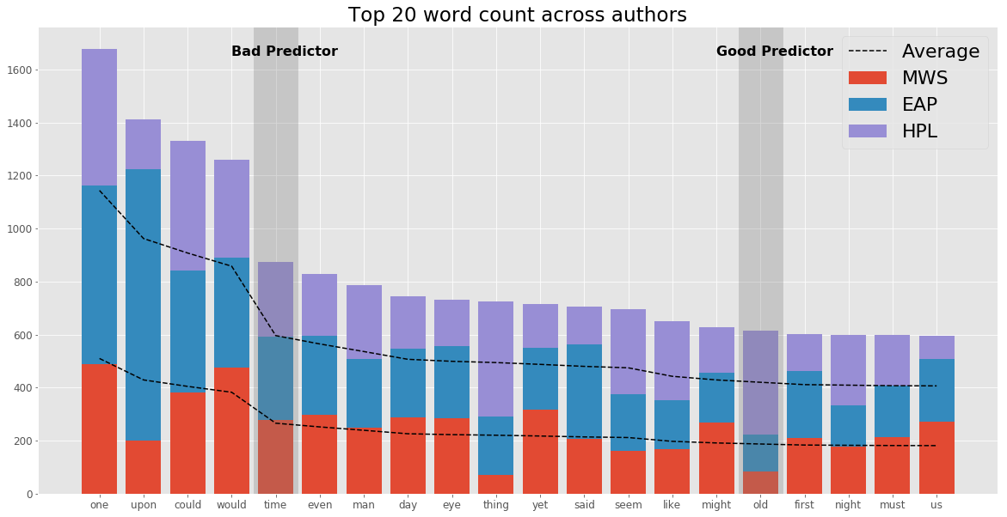
Exploratory Data Analysis - Common Words (Frequencies)

Slide 8
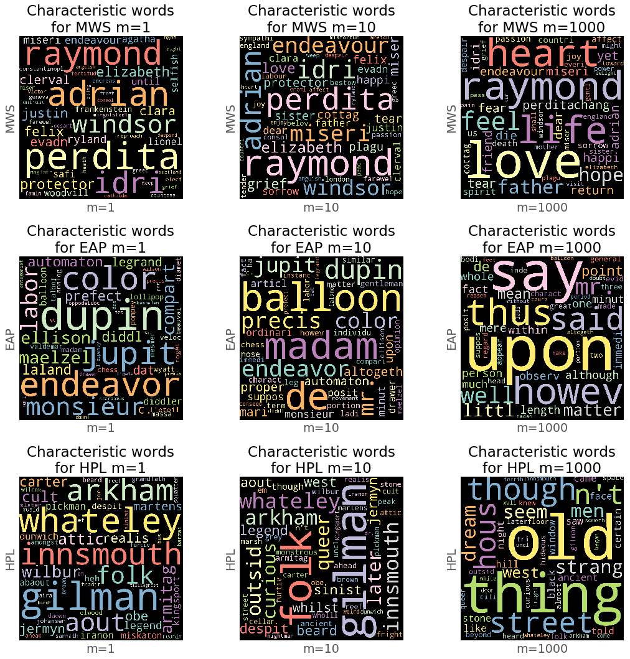
Exploratory Data Analysis - Characteristic words

Slide 9
Implementation Steps
Load the Data
Split dataset for training and testing
Extracting features from text - Bag of Words approach
1] Tokenizing
2] Occurrences of frequencies
Train a classifier
Evaluation of performance on test set
Building a pipeline
Benchmarking Classifiers
Parameter Tuning with grid search cv
Keep track of accuracy and log loss at every step

Slide 10
Dataset pre-processing
Splitting dataset into training and testing
Extracting features from text data
Bag of words : turn the text content into numerical feature vectors
1] Tokenizing text with scikit-learn : CountVectorizer : convert a collection of text documents to a matrix of token counts
2] From occurrences to frequencies
TfidfTransformer : Transforming a count matrix to tf-idf representation
Alternatively , Using TfidfVectorizer we get the same results.
Reference : http://scikit-learn.org/stable/tutorial/text_analytics/working_with_text_data.html

Slide 11
Training a classifier
Training the classifier
Considered classifier algorithm: Multinomial Naive Bayes as it provides good baseline for word counts
Building the pipeline
In order to make the vectorizer => transformer => classifier easier to work.
Evaluation of the performance
Accuracy score: 0.802655771195
Log Loss: 0.60978207366

Slide 12
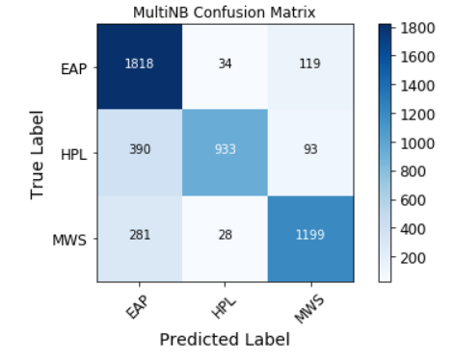

Slide 13
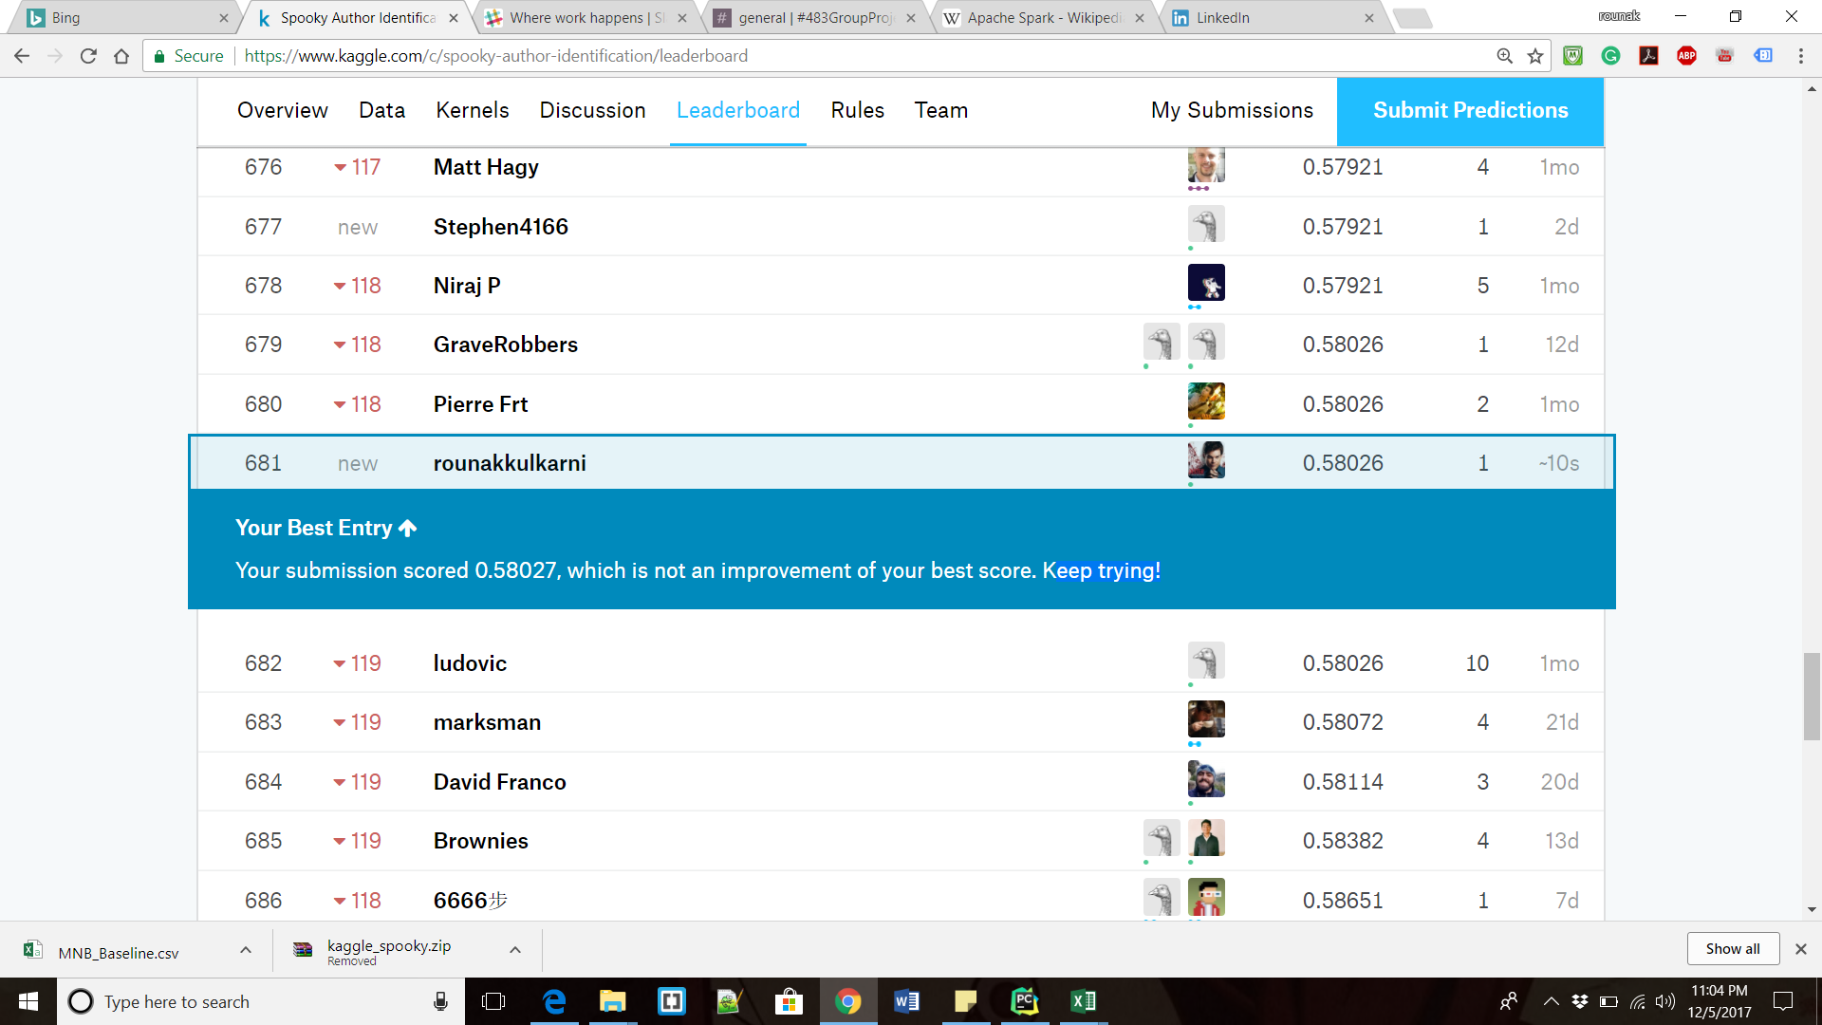
First Submission

Slide 14
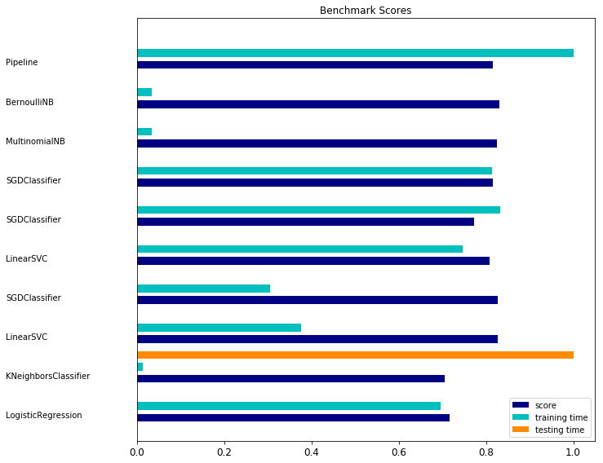
Enhancement
Benchmark classifier
Comparing Multiple Classifier (Logistic Regression, KNN, Linear SVC, SGD, Naïve Bayes Multinomial , Bernoulli Naïve Bayes)
MultinomialNB
It gives the best results among all as logloss is more with BernoulliNB.
We selected MultinomialNB for getting better result by tuning parameters using grid search

Slide 15
 | FEATURES | ACCURACY | FEATURES | ACCURACY
LogisticRegression | EAP: lady said length minutes madame character fact say matter mr HPL: later ancient men told gilman thing west street things old MWS: england hope idris heart life father adrian love perdita raymond | 0.821 | EAP: mr the said very have it at however is upon HPL: thing things men west street seemed old and had though MWS: our you your perdita to me raymond she my her | 0.739
LinearSVC L2 | EAP: epoch color altogether evident lady precisely oppodeldoc amid dupin madame HPL: musides birch despite pickman west street jermyn innsmouth gilman later MWS: misery ryland sister elizabeth windsor miserable idris adrian perdita raymond | 0.799 | EAP: nose oppodeldoc evident precisely epoch vicinity lady madame dupin upon HPL: street johansen uncle normal despite innsmouth birch west later though MWS: windsor plague towards cottage elizabeth miserable idris perdita adrian raymond | 0.831
SGDClassifier L2 | EAP: minutes altogether fact immediately character evident amid dupin lady madame HPL: birch pickman despite jermyn uncle innsmouth street gilman west later MWS: feelings father plague love miserable windsor idris adrian perdita raymond | 0.794 | EAP: precisely is dupin evident however minutes altogether madame lady upon HPL: despite ahead birch whilst uncle street innsmouth later west though MWS: her england miserable cottage plague idris towards perdita adrian raymond | 0.831
LinearSVC L1 | EAP: evident metzengerstein dupin kate jupiter velocity oppodeldoc color amid madame HPL: ahead carter musides despite brown iranon arkham innsmouth later gilman MWS: sister elizabeth ryland windsor kirwin protector idris perdita adrian raymond | 0.78 | EAP: upon jupiter fro colored kate oppodeldoc equivocal madame vicinity dupin HPL: miskatonic iranon slater innsmouth arkham later gilman musides despite johansen MWS: miserable ryland felix painful labours greece idris perdita adrian raymond | 0.812
SGDClassifier L1 | EAP: jupiter mr minutes monsieur evident lady character color amid madame HPL: outside whilst pickman street jermyn despite west innsmouth later gilman MWS: endeavoured miserable tears plague felix windsor idris adrian perdita raymond | 0.736 | EAP: dupin balloon lady immediately evident altogether minutes madame upon vicinity HPL: street wholly arkham uncle gilman west innsmouth later though despite MWS: miserable plague cottage windsor towards felix idris perdita adrian raymond | 0.785
SGDClassifier Elastic | EAP: minutes fact immediately altogether character amid evident dupin lady madame HPL: birch pickman despite jermyn uncle innsmouth street gilman west later MWS: father quitted love plague miserable windsor idris adrian perdita raymond | 0.792 | EAP: manner is dupin evident however minutes madame altogether lady upon HPL: ahead birch despite whilst street uncle later innsmouth west though MWS: her england miserable cottage plague idris towards perdita adrian raymond | 0.826
MultinomialNB | EAP: length matter did long great time man little say said HPL: time came saw thing man night things like did old MWS: eyes time said father did heart perdita love life raymond | 0.814 | EAP: my that was is it in to and of the HPL: it he that had was in to of and the MWS: his me in was her my to of and the | 0.832
BernoulliNB | EAP: having eyes did long great man time say little said HPL: thing came saw time things night man like did old MWS: father man said did time eyes heart love raymond life | 0.821 | EAP: at with was that it in to and of the HPL: it he had that was in to of and the MWS: me with that was my in to of and the | 0.839

Slide 16
Parameter tuning using grid search MultinomialNB with stop words
Multinomial Classifiers tend to have many parameters including the smoothing parameter alpha.
Hence, performing exhaustive search of the best parameters on a grid of possible values

Slide 17
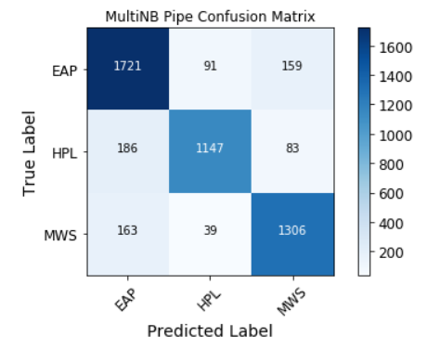

Slide 18
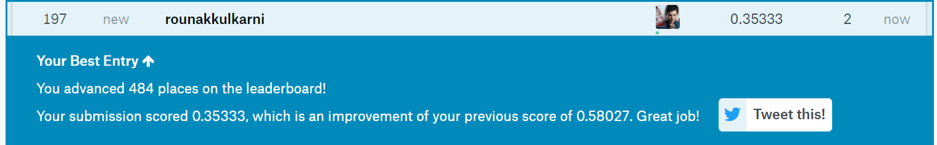
Bingo

Slide 19
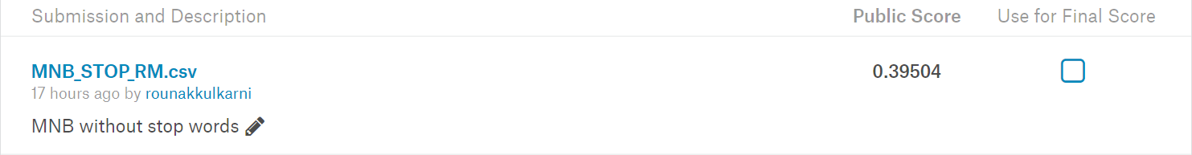
Parameter tuning using grid search MultinomialNB without stop words
After getting result for multinomial with stop word we tried to get better result by removing the stop words
The result we got :

Slide 20
Experiment 2 : N-gram
Limitation of Bag of Word Approach:
It doesn’t capture phrases and multi-word expression as it is a collection of unigram.
Limitation of N-gram :
It doesn’t account for word derivations and internal structure of the sentences.

Slide 21
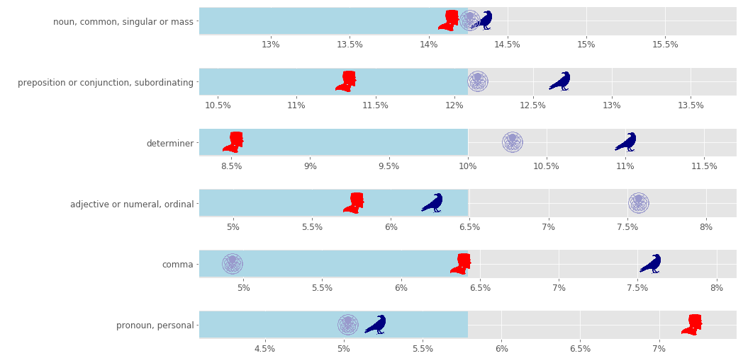
Experiment 3: Lemmatization
Aim: To uncover grammar insights of the sentences

Slide 22
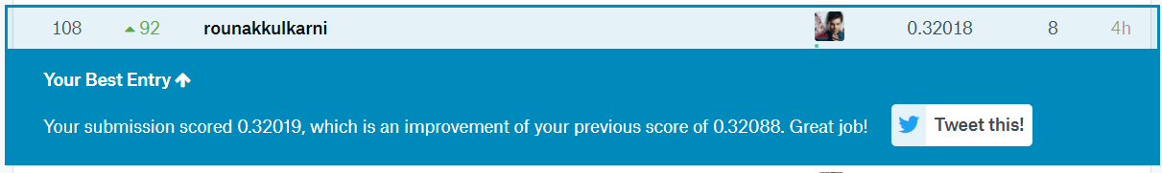
Experiment 3: Lemmatization
Steps:
1] Token_Pattern: Parameter of CountVectorizer,
To incluse comma,
2] Binary : Parameter of CountVectorizer,
To get better features
3] StemTokenizer and Lemmatizer Class: To lemmatize words with/without sentence.
Result:

Slide 23
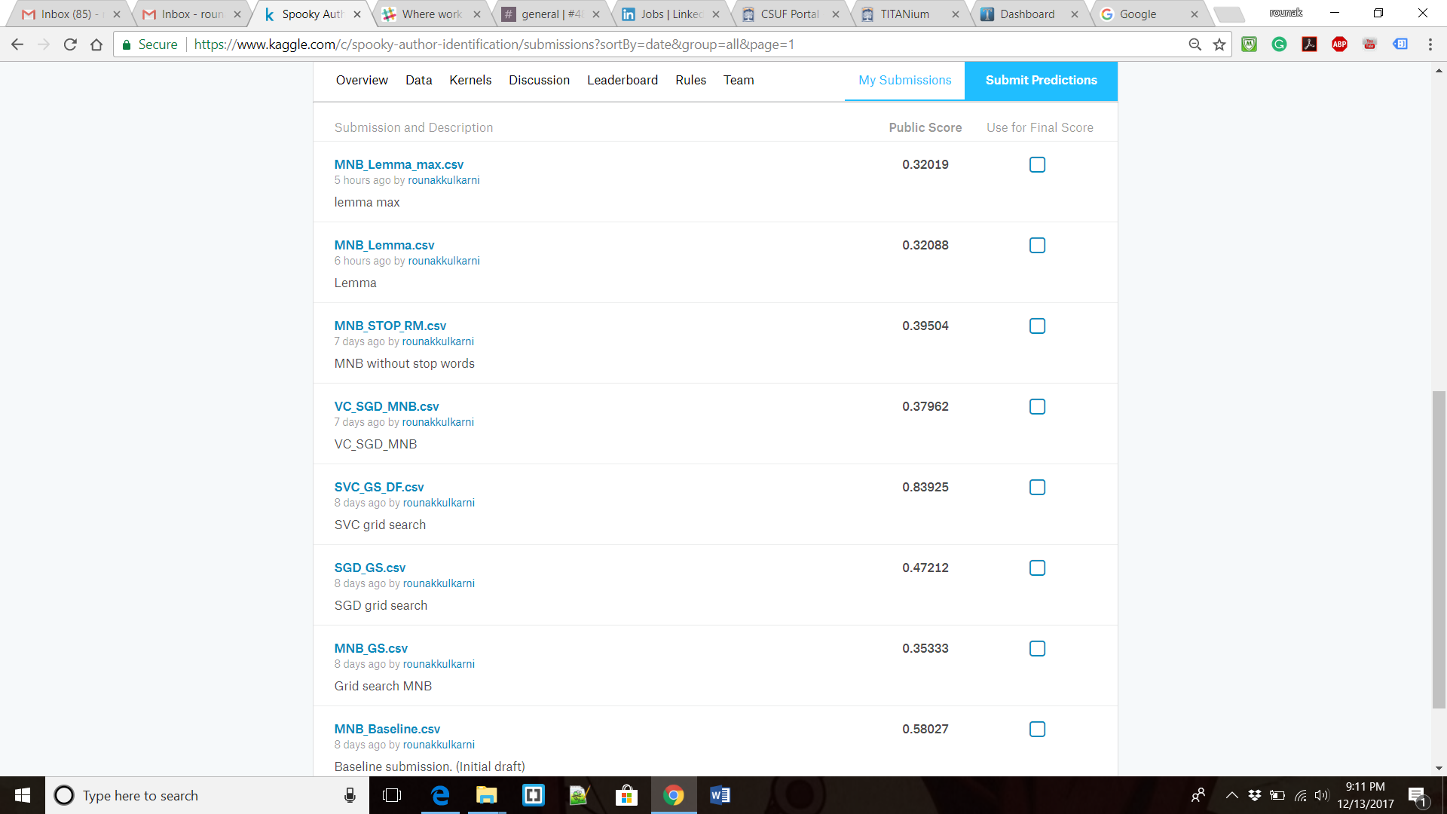
Result of All Submissions

Slide 24
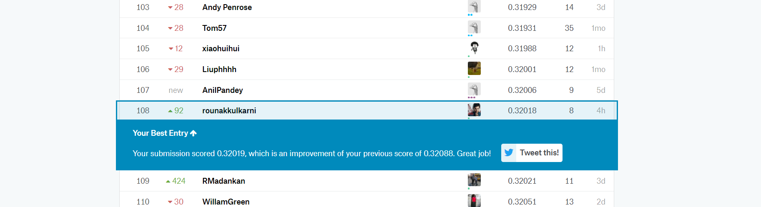
Result of All Submissions

Slide 25
Fun Experiment
AutoML
It is an automated machine learning toolkit and a drop-in replacement for a scikit-learn astimator.
AutoMl frees user from algorithm selection and hyperparameter tuning.
It leverages Bayesian optimization, meta-learning and ensemble construction.

Slide 26




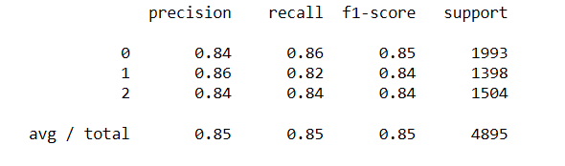

Training results for AutoML

Slide 27
Future Scope/ Discussion
We can include more data processing by limiting author occurrences.
We can use neural networks model like Multi-Layer Perceptron model.
Very simple preprocessing can be done/ other approach can be used.
More advanced preprocessing can be done such as including
Sentence length
Word Sequences
Parts of Speech

Slide 28
Conclusion And Learnings
MultinomialNB was the best out of box classifier for this competition.
Allocate enough time for GridSearch.
A more time should be spent on EDA (Exploratory Data Analytics), an approach to analyzing the dataset to summarize the main characteristics often with visual methods.
EDA saves time
Visual methods can help to percept the approach

Slide 29
Reference
https://www.kaggle.com/c/spooky-author-identification
https://www.ics.uci.edu/~pattis/ICS-33/lectures/re.txt
http://scikit-learn.org/stable/tutorial/text_analytics/working_with_text_data.html
http://scikit-learn.org/stable/auto_examples/text/document_classification_20newsgroups.html#sphx-glr-auto-examples-text-document-classification-20newsgroups-py
http://scikit-learn.org/stable/modules/feature_extraction.html#text-feature-extraction
http://scikit-learn.org/dev/auto_examples/model_selection/grid_search_text_feature_extraction.html
http://scikit-learn.org/stable/modules/feature_extraction.html#applications-and-examples
http://scikit-learn.org/stable/modules/ensemble.html#using-the-votingclassifier-with-gridsearch
https://www.kaggle.com/marcospinaci/talking-plots-1-sklearn-classifiers-0-334

